Slide 1
2024 IEEE 4th Mysore Sub Section International Conference (MysuruCon) IEEE Conference Record No: 62630, Date: 30th & 31st August 2024 Venue: Vidya Vikas Institute of Engineering and Technology, VVIET, Mysuru.
Paper ID : 596
Title of the paper: Validation of Vision Transformer Over Convolutional Neural Networks-based Pretrained Model for Schizophrenia Diagnosis
Author Names: Mohan V, Nithin Rajaseharan , Taushiq Balamurugan, Varun S,
Suguna G, Harikumar M E
https://www.mysurucon.org/

Slide 2
Content
Abstract
Introduction
Literature Survey
Problem Definition
Implementation
Methodology
Results
References
Vidya Vikas Institute of Engineering and Technology MYSURUCON 2024: https://www.mysurucon.org/

Slide 3
Abstract
Schizophrenia, a severe mental disorder, affects individuals’ perception of reality. The present diagnostic approach relies on the subject evaluation of clinical symptoms by the psychiatrist.
With the advancement in deep learning with the concept of self-attention mechanism, the novel vision transformer model with transformer encoder is utilized and showed an accuracy and sensitivity of 0.96 and 0.97 outperforming other CNN models.
With the higher sensitivity score ensures confidence in correct diagnosis. Automating the diagnostic evaluation process of MRI scans with a vision transformer model will aid the psychiatrists.
Vidya Vikas Institute of Engineering and Technology MYSURUCON 2024: https://www.mysurucon.org/

Slide 4

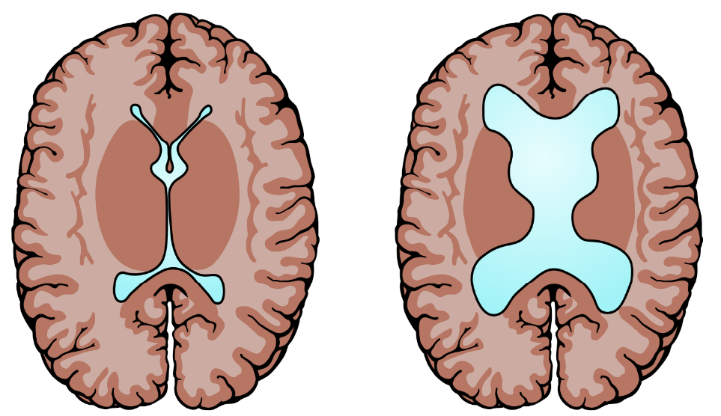
Introduction
Schizophrenia - Abnormal interpretation
of reality.
Symptoms : hallucinations, delusions, disorganized thinking, and emotional disturbances.
According to WHO, 20 million people worldwide have schizophrenia.
Brain abnormalities:
Reduced gray matter volume
Enlarged ventricles
White matter abnormalities
Vidya Vikas Institute of Engineering and Technology MYSURUCON 2024: https://www.mysurucon.org/

Slide 5
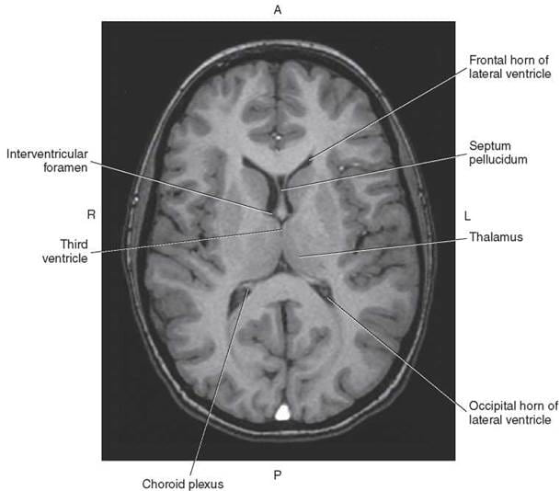
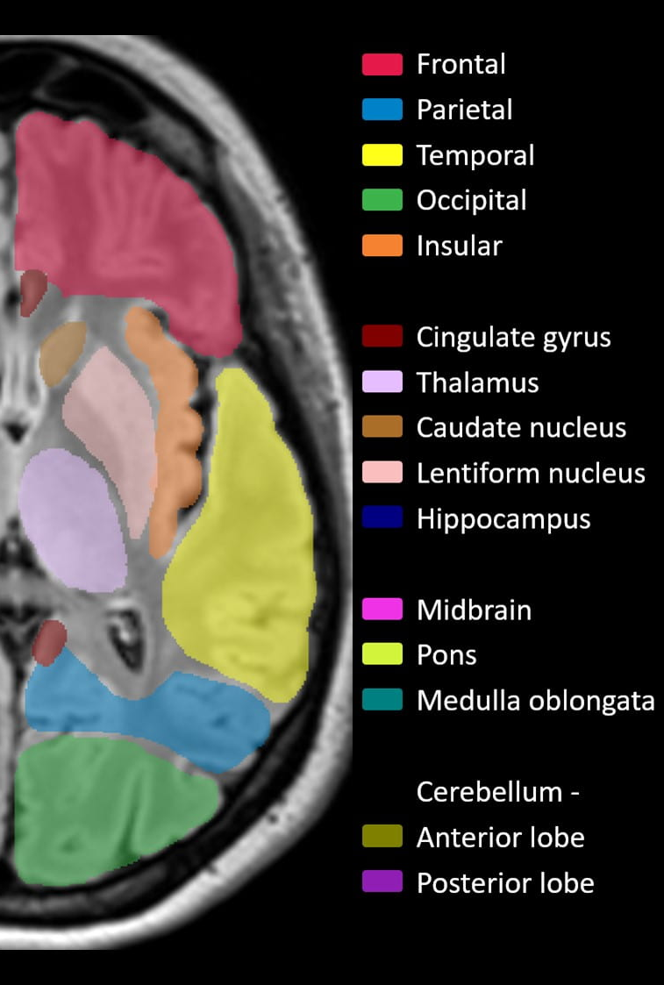
Introduction
Vidya Vikas Institute of Engineering and Technology MYSURUCON 2024: https://www.mysurucon.org/

Slide 6
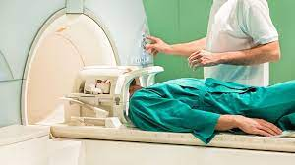

Problem Definition
Subjective evaluation by psychiatrist.
Neuroradiologists interprets MRI images and provide diagnostic report.
Psychiatrist evaluates the report.
This manual examination is a time-consuming process.
Misdiagnosis due to lack of CAD system for evaluation.
Vidya Vikas Institute of Engineering and Technology MYSURUCON 2024: https://www.mysurucon.org/

Slide 7
Literature Survey
S.No | Paper Title | Publication | Year | Inference
1 | Framework to Detect Schizophrenia in Brain MRI Slices with Mayfly Algorithm-Selected Deep and Handcrafted Features | Journal of Sensors, vol. 23, no. 1, pp. 280, Multidisciplinary Digital Publishing Institute(MDPI) | 2022 | fMRI dataset – 40 images VGG, ResNet, Inception models Accuracy – VGG16 - 91%
2 | Diagnosis of schizophrenia based on deep learning using fMRI | Computational and Mathematical Methods in Medicine, Hindawi Limited | 2021 | Preprocessed fMRI data Transfer learning for VGG16 Accuracy – 87.85%
3 | Brain MRI-based 3D Convolutional Neural Networks for Classification of Schizophrenia and Controls | International Conference of the IEEE Engineering in Medicine & Biology Society (EMBC), IEEE | 2020 | 3D CNN model GM and WM based ML model Performance of CNN model is better than ML model.
Vidya Vikas Institute of Engineering and Technology MYSURUCON 2024: https://www.mysurucon.org/

Slide 8
Literature Survey
S.No. | Paper Title | Publication | Year | Inference
4 | Predicting Schizophrenia from fMRI Using Deep Learning | Springer Science and Business Media | 2022 | DL model with SVC for fMRI data Accuracy: 88%
5 | Machine learning techniques for the Schizophrenia diagnosis: a comprehensive review and future research directions | Springer Science and Business Media | 2023 | For accurate prediction, selective feature extraction and selection of model is important Performance of DL method is better than ML method.
6 | Towards artificial intelligence in mental health: a comprehensive survey on the detection of schizophrenia | Multimedia Tools and Applications, John Wiley and Sons Ltd | 2023 | CAD systems assist radiologists and doctors in the early diagnosis Deep learning is the most effective method.
Vidya Vikas Institute of Engineering and Technology MYSURUCON 2024: https://www.mysurucon.org/

Slide 9
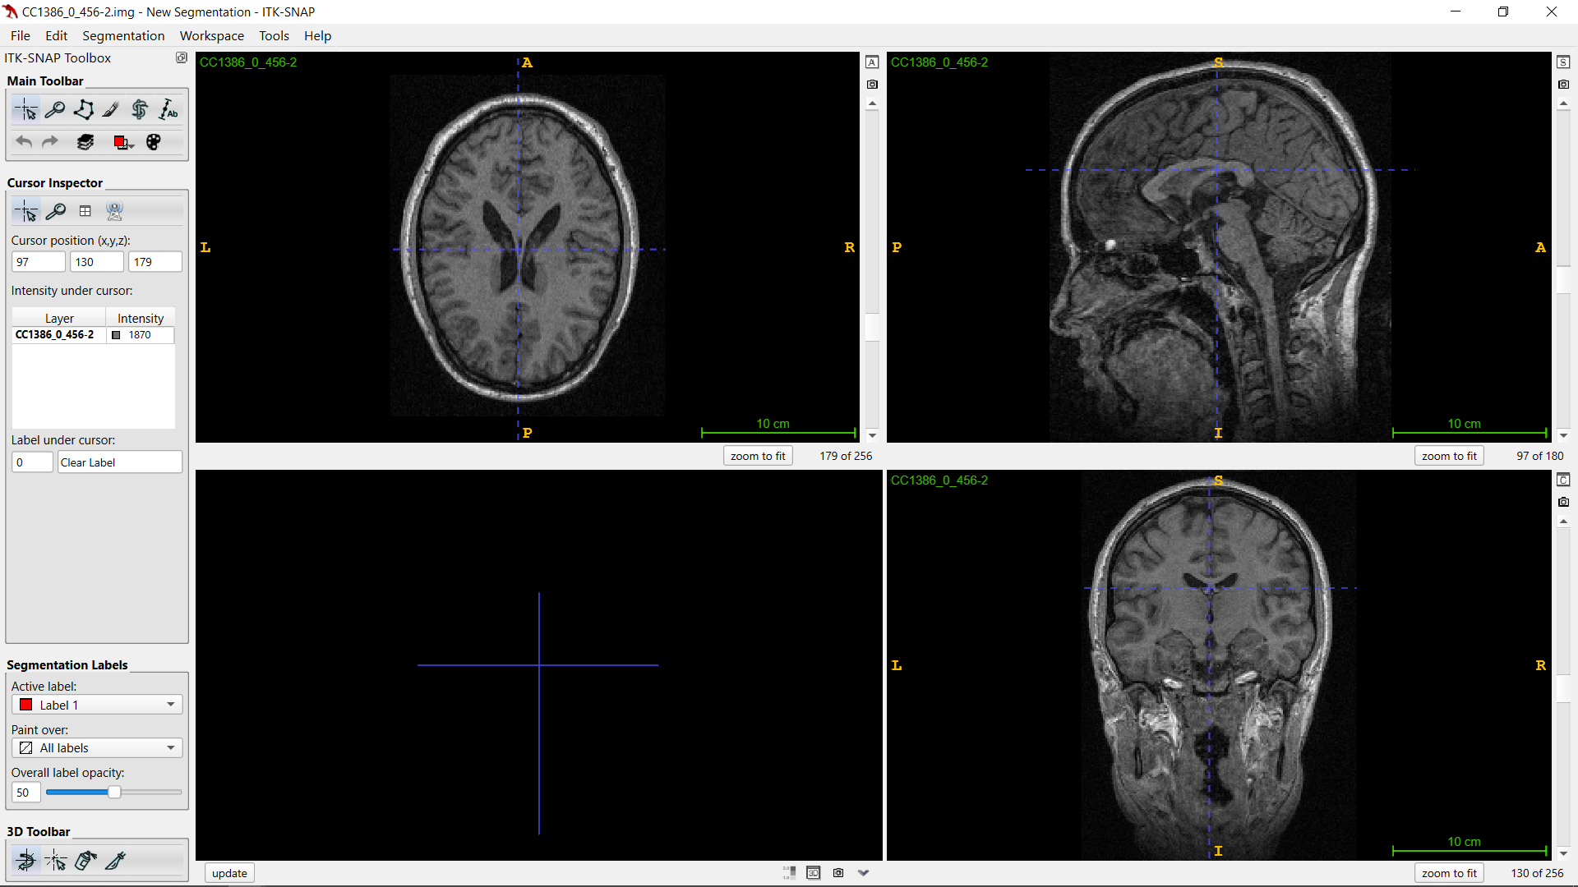
Implementation
Data Pre-processing
Axial
Sagittal
Software:
ITK-Snap
Coronal
Vidya Vikas Institute of Engineering and Technology MYSURUCON 2024: https://www.mysurucon.org/

Slide 10
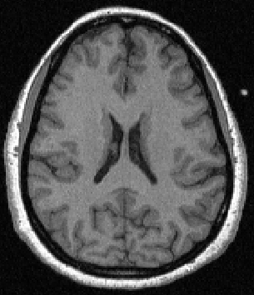
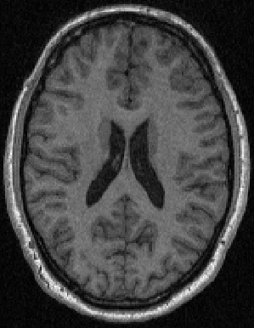
Implementation
Data Pre-processing
Source: NUSDAST
Healthy : 125
Schizophrenia: 125
Healthy fMRI Axial plane
Schizophrenia fMRI Axial plane
Vidya Vikas Institute of Engineering and Technology MYSURUCON 2024: https://www.mysurucon.org/
10

Slide 11
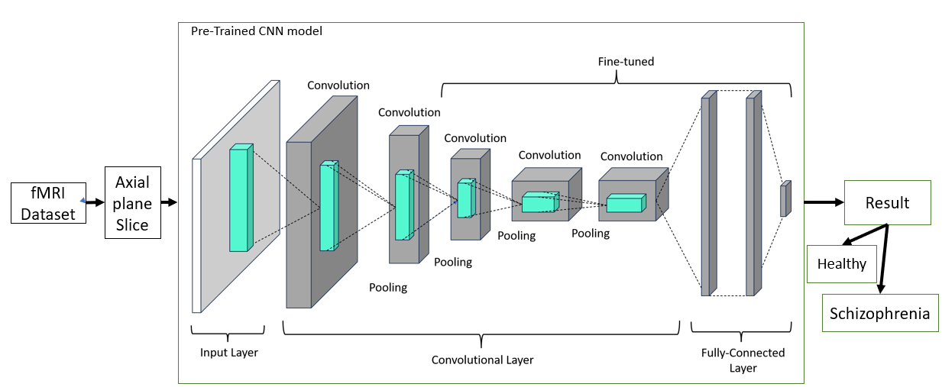
Methodology
CNN Model Methodology
Vidya Vikas Institute of Engineering and Technology MYSURUCON 2024: https://www.mysurucon.org/
11

Slide 12
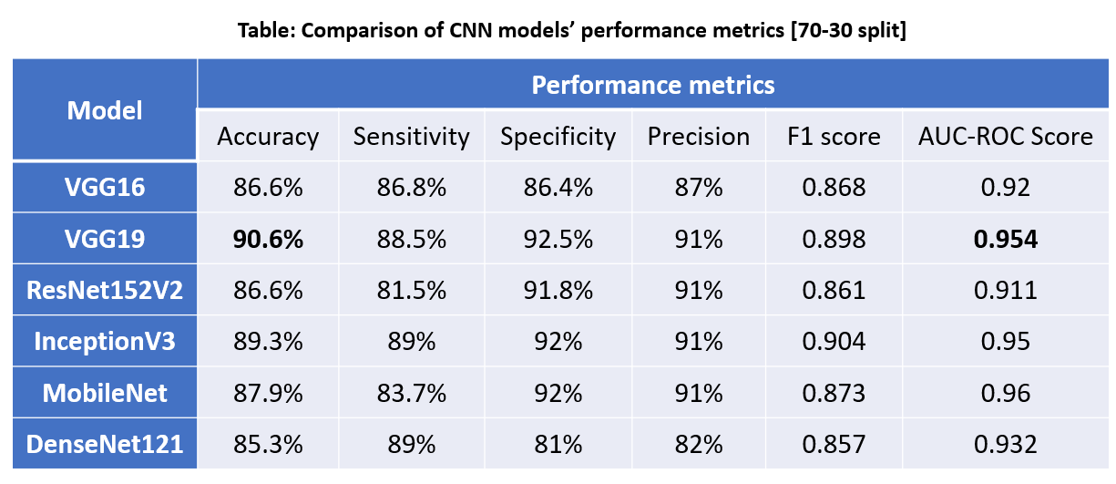
Results
CNN Model Results
Vidya Vikas Institute of Engineering and Technology MYSURUCON 2024: https://www.mysurucon.org/

Slide 13
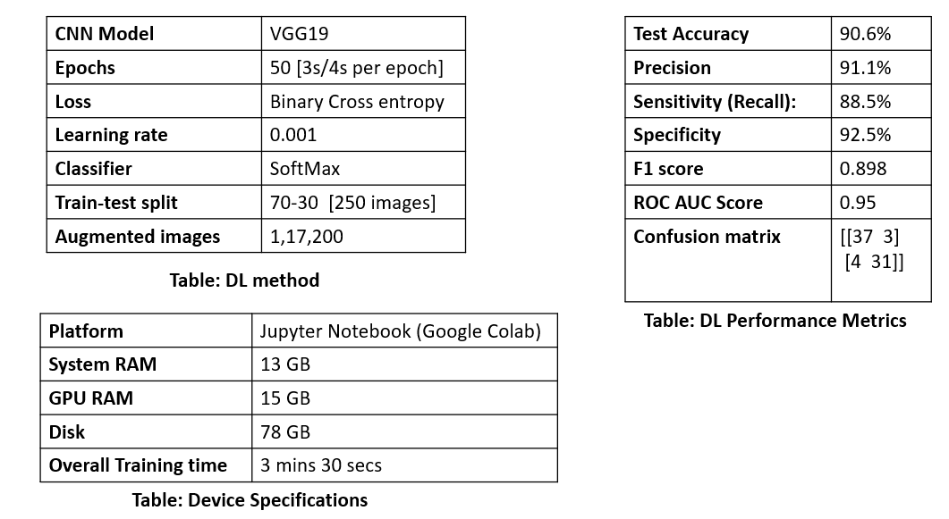
Results
VGG19 Model result
Vidya Vikas Institute of Engineering and Technology MYSURUCON 2024: https://www.mysurucon.org/

Slide 14
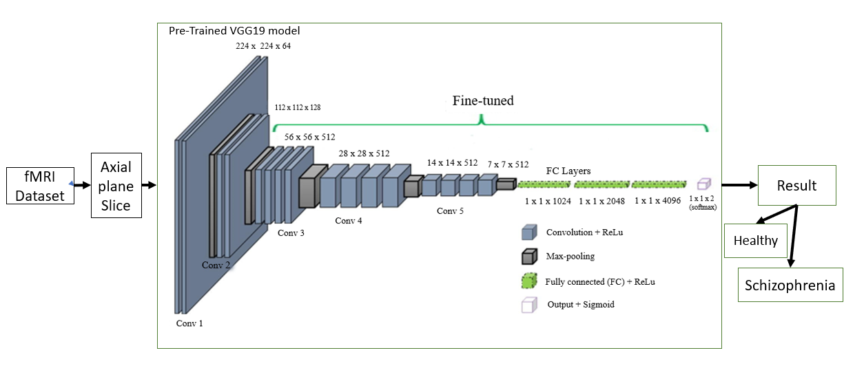
Results
VGG19 Model Methodology
Vidya Vikas Institute of Engineering and Technology MYSURUCON 2024: https://www.mysurucon.org/

Slide 15
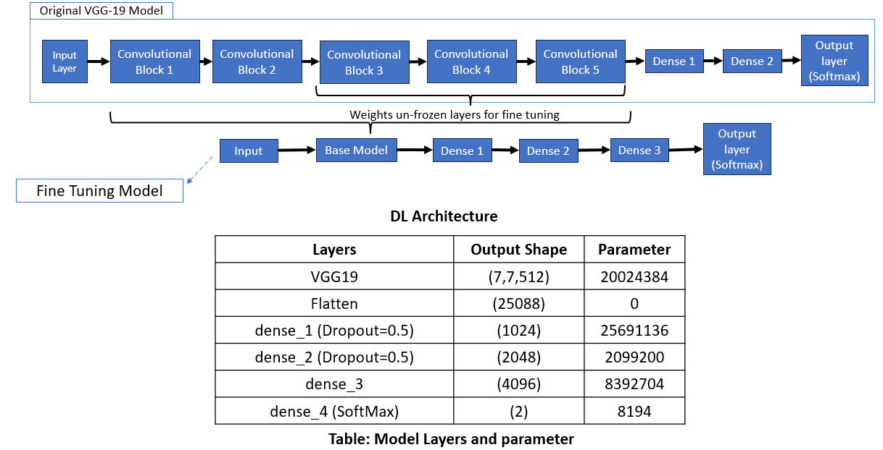
Results
VGG19 Architecture
Vidya Vikas Institute of Engineering and Technology MYSURUCON 2024: https://www.mysurucon.org/

Slide 16
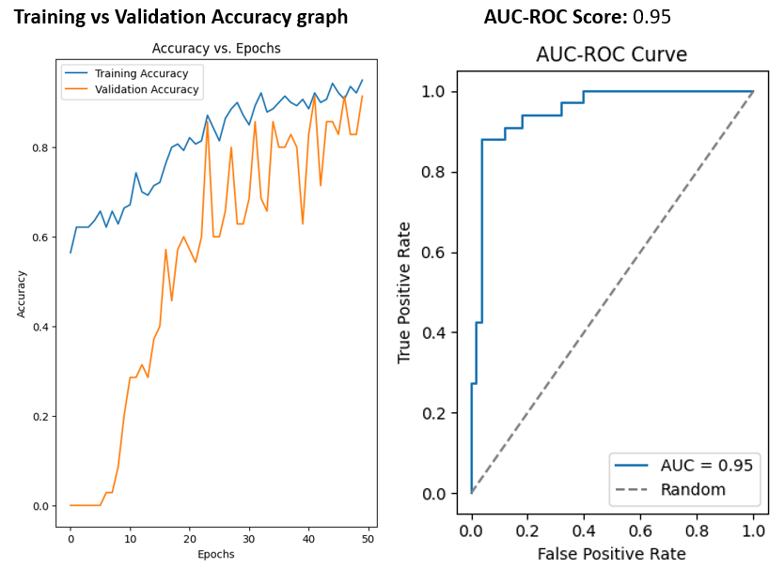
Results
VGG19 result
Vidya Vikas Institute of Engineering and Technology MYSURUCON 2024: https://www.mysurucon.org/

Slide 17
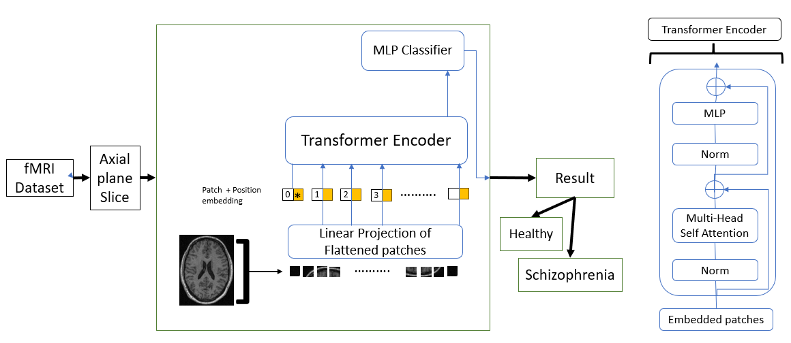
Methodology
ViT Model Methodology
Vidya Vikas Institute of Engineering and Technology MYSURUCON 2024: https://www.mysurucon.org/
17

Slide 18
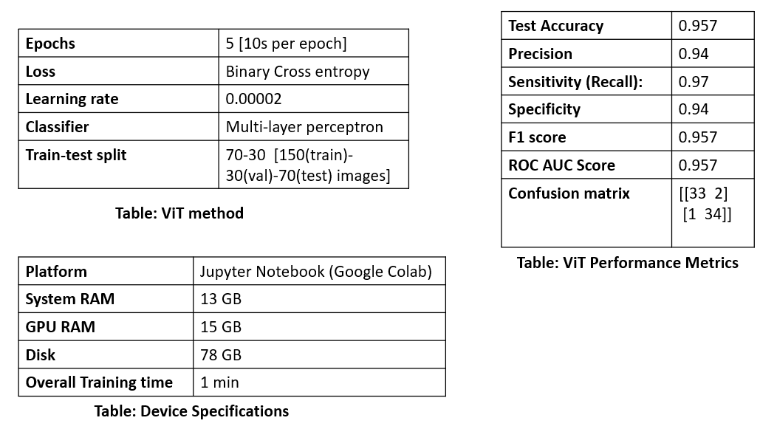
Results
ViT model result
Vidya Vikas Institute of Engineering and Technology MYSURUCON 2024: https://www.mysurucon.org/

Slide 19
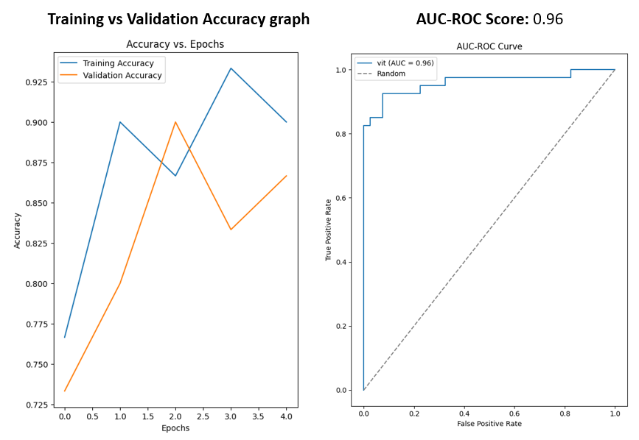
Results
ViT Result
Vidya Vikas Institute of Engineering and Technology MYSURUCON 2024: https://www.mysurucon.org/

Slide 20
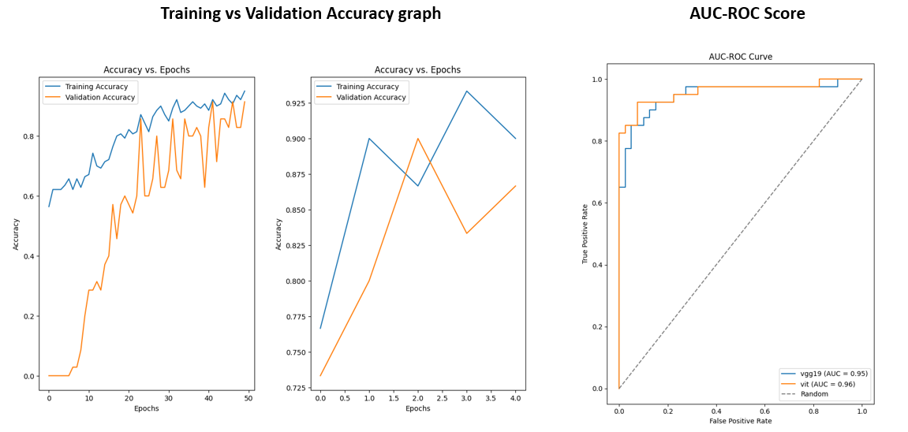
Results
Comparison of CNN and ViT result
Vidya Vikas Institute of Engineering and Technology MYSURUCON 2024: https://www.mysurucon.org/

Slide 21
Results
Comparison with other works
Dataset | Modality | Methods | Performance | References
COBRE / SCZ-102, HC-98 | fMRI | ML and VGG16 | Acc-94.3% | [1]
COBRE / SCZ-102, HC-98 | fMRI | VGG16 | Acc-84% | [2]
OpenNeuro / SCZ-20, HC – 20 | fMRI | VGG19 | Acc-91% | [11]
OpenNeuro / SCZ-20, HC – 20 | fMRI | VGG16, VGG19, InceptionV3 | Acc-91% | [12]
NUSDAST/ SCZ-125, HC-125 | fMRI | ViT | Acc - 96% | Proposed Work
Vidya Vikas Institute of Engineering and Technology MYSURUCON 2024: https://www.mysurucon.org/

Slide 22
References
Manic, K. S., Rajinikanth, V., Al-Bimani, A. S., Taniar, D., & Kadry, S. (2022), “Framework to Detect Schizophrenia in Brain MRI Slices with Mayfly Algorithm-Selected Deep and Handcrafted Features”, Journal of Sensors, vol. 23, no. 1, pp. 280, Multidisciplinary Digital Publishing Institute(MDPI), 2022.doi: https://doi.org/10.3390/s23010280
Zheng, JinChi, et al. , "Diagnosis of schizophrenia based on deep learning using fMRI“, Computational and Mathematical Methods in Medicine, Hindawi Limited, 2021. doi: https://doi.org/10.1155/2021/8437260
Chen, ZhiHong, et al. "Detecting abnormal brain regions in schizophrenia using structural MRI via machine learning." Computational intelligence and neuroscience, Hindawi Limited, 2020. doi: https://doi.org/10.1155/2020/6405930
Liu, Dong, et al. "Fusion of handcrafted and deep features for medical image classification." Journal of Physics: Conference Series, vol. 1345. No. 2. Institute of Physics Publishing Publishing, 2019. doi: https://doi.org/10.1088/1742-6596/1345/2/022052
de Filippis R, Carbone EA, Gaetano R, Bruni A, Pugliese V, Segura-Garcia C, De Fazio P, “Machine learning techniques in a structural and functional MRI diagnostic approach in schizophrenia: a systematic review”, Neuropsychiatric Disease Treatment : 1605-1627, Dove Medical Press Ltd, 2019. doi: https://doi.org/10.2147/NDT.S202418
Vidya Vikas Institute of Engineering and Technology MYSURUCON 2024: https://www.mysurucon.org/

Slide 23
References
M. Hu, K. Sim, J. H. Zhou, X. Jiang and C. Guan, "Brain MRI-based 3D Convolutional Neural Networks for Classification of Schizophrenia and Controls," 2020 42nd Annual International Conference of the IEEE Engineering in Medicine & Biology Society (EMBC), pp. 1742-1745, 2020. doi: https://10.1109/EMBC44109.2020.9176610
Kardani, Shail, Raghav Sharma, and Abhishek Sharma, "Predicting Schizophrenia from fMRI Using Deep Learning." In International Conference on Innovations in Computational Intelligence and Computer Vision, pp. 177-187, Springer Nature, 2022. doi: http://dx.doi.org/10.1007/978-981-99-2602-2_15
Verma, S., Goel, T., Tanveer, M., Ding, W., Sharma, R., & Murugan, R. , "Machine learning techniques for the Schizophrenia diagnosis: A comprehensive review and future research directions" , Journal of Ambient Intelligence and Humanized Computing, vol.14(5), pp. 4795-4807, Springer Science, 2023. doi: https://doi.org/10.1007/s12652-023-04536-6
Mateos-Pérez, José María, Mahsa Dadar, María Lacalle-Aurioles, Yasser Iturria-Medina, Yashar Zeighami, and Alan C. Evans, "Structural neuroimaging as clinical predictor: A review of machine learning applications.“, NeuroImage: Clinical vol. 20 pp. 506-522, Elsevier Inc. ,2018. doi: https://doi.org/10.1016/j.nicl.2018.08.019
Tyagi, Ashima, Vibhav Prakash Singh, and Manoj Madhava Gore. "Towards artificial intelligence in mental health: a comprehensive survey on the detection of schizophrenia." Multimedia Tools and Applications 82, no. 13 , pp. 20343-20405., Springer, 2023. doi: https://doi.org/10.1002/brb3.3002
Vidya Vikas Institute of Engineering and Technology MYSURUCON 2024: https://www.mysurucon.org/

Slide 24
References
S. Kadry, D. Taniar, R. Damasevicius, and V. Rajinikanth, “Automated Detection of Schizophrenia from Brain MRI Slices using Optimized Deep-Features,” Proceedings of 2021 IEEE 7th International Conference on Bio Signals, Images and Instrumentation, ICBSII 2021, Mar. 2021, doi: https://10.1109/ICBSII51839.2021.9445133
J. Zhang et al., “Detecting schizophrenia with 3D structural brain MRI using deep learning,” Scientific Reports, vol. 13, no. 1, 2023 doi: https://doi.org/10.48550/arXiv.2206.12980
Ashish Vaswani et al., “Attention is All you Need,” Neural Information Processing Systems, vol 10, pp 13-19, 2017, doi: https://doi.org/10.1016/j.ebiom.2023.104512
Vidya Vikas Institute of Engineering and Technology MYSURUCON 2024: https://www.mysurucon.org/

Slide 25
Thank you
Vidya Vikas Institute of Engineering and Technology MYSURUCON 2024: https://www.mysurucon.org/

